Slide 1
Applied
Thermodynamics

Slide 2
Thermodynamics
As its name suggests, thermodynamics originally treated the conversion of heat to motion.
Therme (Greek word) means heat
Dynamics means power (Power developed from the heat)
Science of energy transfer and its effect on the properties of the system
Thermodynamics is a branch of physical science that deals with the relations between heat and other forms of energy (such as mechanical, electrical, or chemical energy), and, by extension, of the relationships between all forms of energy.

Slide 3
Brief History
It was first developed in the nineteenth century to increase the efficiency of the steam engines
To describe the operation of the steam engine and to determine the limits of what these engines could accomplish
The principles observed to be valid for steam engines are readily generalised (through logic and mathematical expressions) in the form of First and Second law of thermodynamics which find applications in all branches of science and engineering.

Slide 4
Microscopic and macroscopic approaches
Microscopic Thermodynamics: behaviour of individual molecules is taken into consideration.
Also known as statistical thermodynamics
Macroscopic Thermodynamics: Nothing is examined at the atomic or molecular level
Average behaviour of molecules (Bulk properties of the matter) is taken into consideration
Also known as classical thermodynamics
It provides a direct and easy way to the solution of engineering problems.
Notes:
It is well-known that a substance consists of a large number of particles
called molecules. The properties of the substance naturally depend on the
behavior of these particles. For example, the pressure of a gas in a container
is the result of momentum transfer between the molecules and the walls of
the container. However, one does not need to know the behavior of the gas particles
to determine the pressure in the container. It would be sufficient to
attach a pressure gage to the container. This macroscopic approach to the
study of thermodynamics that does not require a knowledge of the behavior
of individual particles is called classical thermodynamics.

Slide 5
Applications
All activities in nature involve some interaction between energy and matter; thus, it is hard to imagine an area that does not relate to thermodynamics in some manner.
Therefore, developing a good understanding of basic principles of thermodynamics has long been an essential part of engineering education.

Slide 6
Many ordinary household appliances are designed, in whole or in part, by using the principles of thermodynamics.
Electric or gas range, Heating and air-conditioning systems, the refrigerator, the humidifier, the pressure cooker, the water heater, the iron, and even the computer and the TV.
It also plays a major part in the design and analysis of automotive engines, rockets, jet engines, and conventional or nuclear power plants, solar collectors, and the design of vehicles from ordinary cars to airplanes.

Slide 7
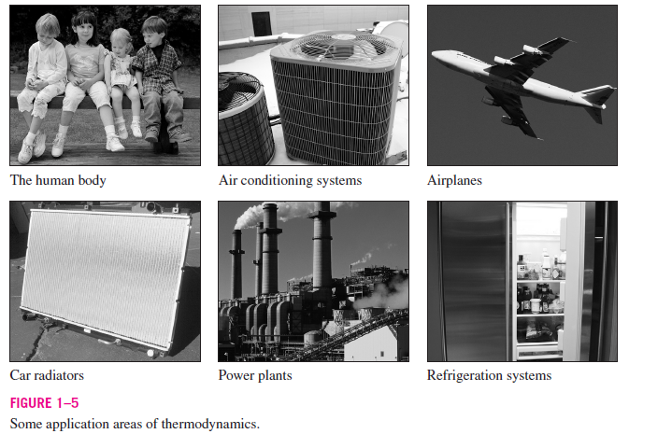

Slide 8
System and Surroundings
In thermodynamics, the universe represents all measured space. It is not very convenient, however, to consider the entire universe every time we need to do a calculation.
Therefore, we break down the universe into the region in which we are interested, the system, and the rest of the universe, the surroundings.
The system is separated from the surroundings by its boundary. The boundary may be real and physical, or it may be an imaginary construct.

Slide 9
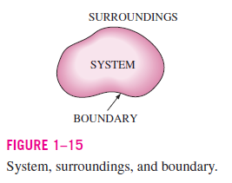
Size of the system can be expressed as:
Mass (m)
Moles (n)
Total volume (V^{t})

Slide 10
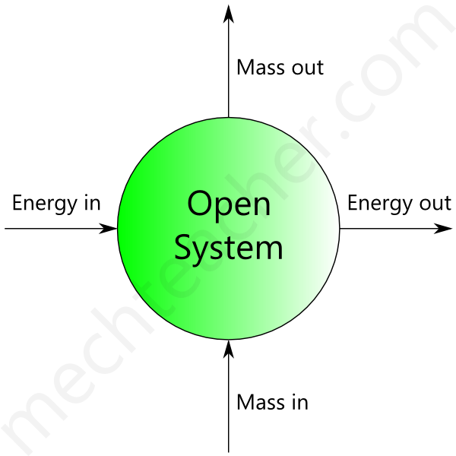
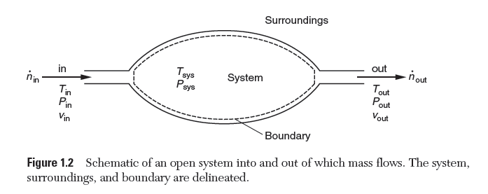
Open System
An open system is a thermodynamic system which allows both mass and energy to flow in and out of it, across its boundary.

Slide 11
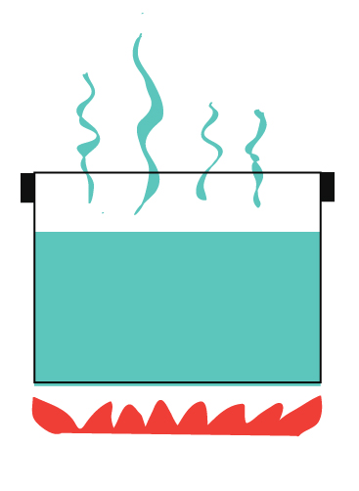
Example of open system: Water heated in an open container – Here, heat is the energy transferred, water is the mass transferred and container is the thermodynamic system. Both heat and water can pass in and out of the container.
Boiling water without a lid.
Heat escape into the air. At the same time
steam (which is matter) also escapes into the air.

Slide 12
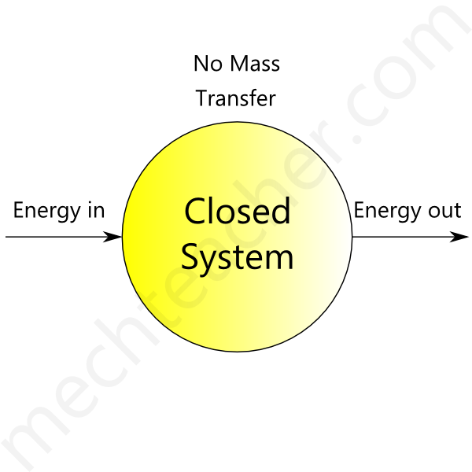
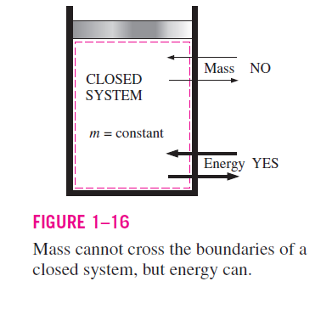
Closed System
A closed system allows only energy (heat and work) to pass in and out of it. It does not allow mass transfer across its boundary.

Slide 13

Example of closed system: Water heated in a closed vessel – Here only heat energy can pass in and out of the vessel.
It allows heat to be transferred from the stove
to the water
Heat is also transferred to the surroundings
Steam is not allowed to escape

Slide 14
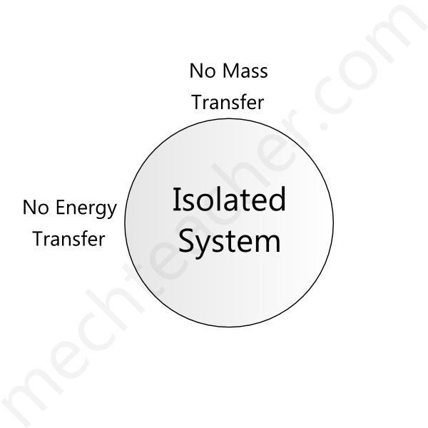
Isolated System
An isolated system does not interact with its surroundings. It does not allow both mass and energy transfer across its boundary. It is more restrictive.
In reality, complete isolated systems do not exist. However, some systems behave like an isolated system for a finite (limited) period of time.

Slide 15
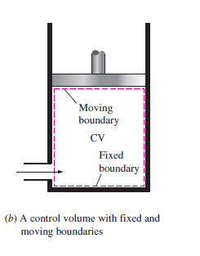
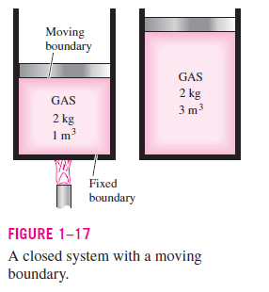
Types of boundary
The boundary of a system can be real or imaginary and can be fixed or movable.

Slide 16
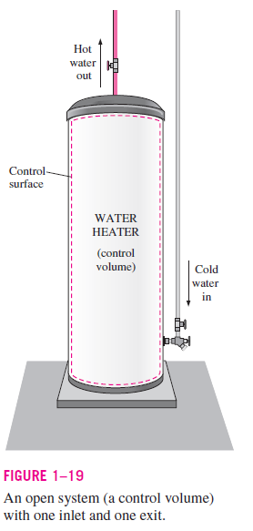
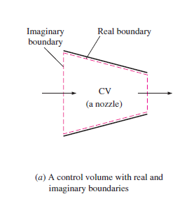

Slide 17
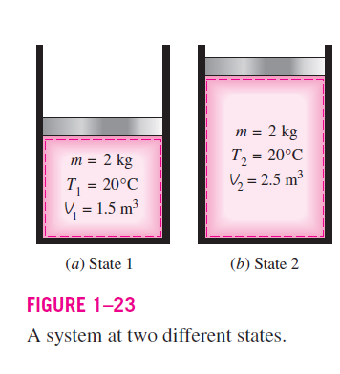
The thermodynamic state of a system is the condition in which we find the system at any given time.
Specified by a set of properties that completely describes the condition, or the state, of the system.

Slide 18
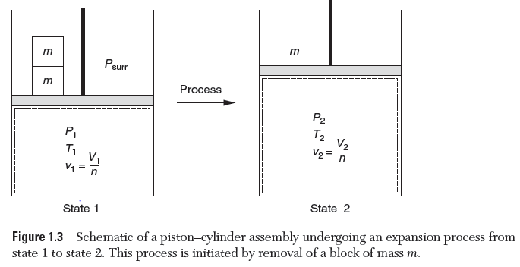
A system is said to undergo a process when it goes from one thermodynamic state to another.
The expansion process takes the system from state 1 to state 2.

Slide 19
Types of processes
In an isothermal process, the temperature of the system remains constant. Changes of state or phase changes of different liquids through the process of melting and evaporation are examples of the isothermal process.
In an adiabatic process, no heat transfer occurs across the system boundary. In nature, one way that happens is when the process is really fast. For example, expansions or compressions of gases in supersonic regimes are adiabatic processes
Notes:
An adiabatic process is a thermodynamic process in which no heat enters or leaves a system during expansion or compression of the fluid composing the system. An example of an adiabatic process is the vertical flow of air in the atmosphere; air expands and cools as it rises, and contracts and grows warmer as it descends.

Slide 20
Similarly, isobaric and isochoric processes occur at constant pressure and volume, respectively.
A simple Isobaric process is boiling water.
Isochoric process when it is assumed that the burning of the gasoline-air mixture in an internal combustion engine car is instantaneous. There is an increase in the temperature and the pressure of the gas inside the cylinder while the volume remains the same.

Slide 21
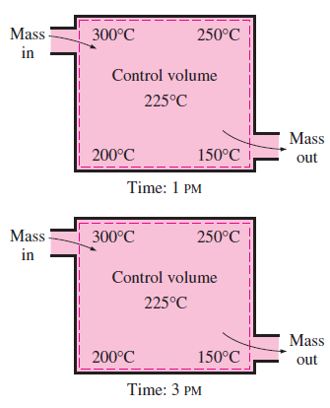
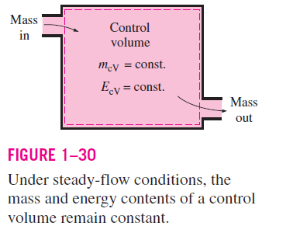
The Steady-Flow Process
The term ‘steady’ implies no change with time.
Steady-flow process can be defined as a process during which a fluid flows through a control volume steadily

Slide 22
State function
A state function is a property whose value does not depend on the path taken to reach that specific value. (e.g. Pressure Volume and Temperature)
Can integrate using final and initial values.
Multiple steps result in same value.

Slide 23
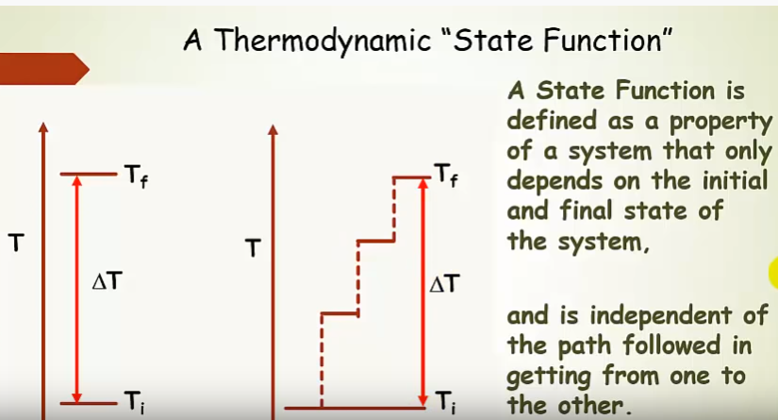

Slide 24
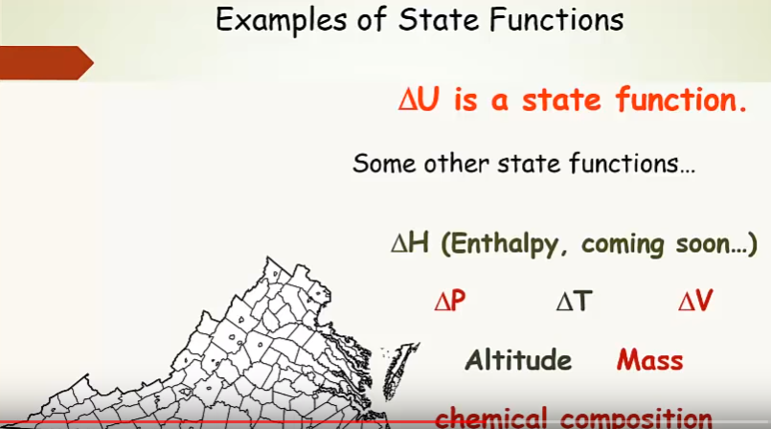

Slide 25
Path function
Dependent on path taken to establish property or value such as heat and work, that depend on path.
Need multiple integrals and limits of integration in order to integrate.
Multiple steps result in different value.

Slide 26
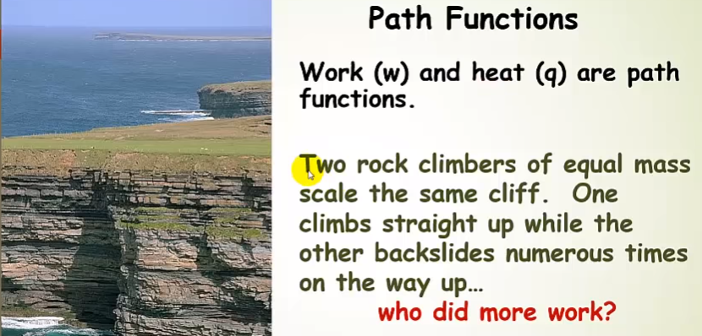

Slide 27
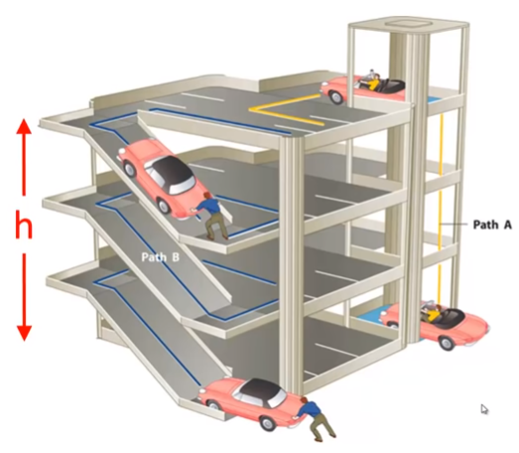

Slide 28
Phases of Matter
A given phase of matter is characterized by both uniform physical structure and uniform chemical composition.
It can be solid, liquid, or gas.
The bonds between the atoms in a solid hold them in a specific position relative to other atoms in the solid. However, they are free to vibrate about this fixed position.
Like a solid, molecules within the liquid phase are in close proximity to one another due to intermolecular attractive forces. However, the molecules in a liquid are not fixed in place by directional bonds; rather, they are in motion, free to move relative to one another.
Gas molecules show relatively weak intermolecular interactions. They move about to fill the entire volume of the container in which they are housed.

Slide 29
Measured thermodynamic properties
Measured thermodynamic properties are those that can be obtained through direct measurement in the lab. These include volume, temperature, and pressure.
Extensive or Intensive Properties
Extensive properties depend on the size of the system…. amount of matter in a sample (e.g. Mass and Volume)
Intensive Properties are independent of the size of the system (colour, temperature, density, and solubility.)
n = 5 mol
V = 100 litres
n = 10 mol
V = 200 litres

Slide 30
Volume (Extensive or Intensive)
Volume is related to the size of the system. For a rectangular geometry, volume can be obtained by multiplying the measured length, width, and height.
This procedure gives us the extensive form of volume, V, in units of m³ or [gal].
Volume can also be described as an intensive property, either as molar volume, (v) m³/mol, or specific volume, (v^) m³/kg.
The specific volume is the reciprocal of density, kg/m³ .

Slide 31
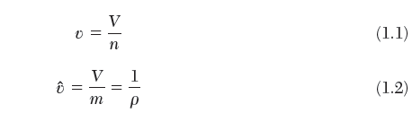
If a substance is distributed continuously and uniformly throughout the system, the intensive forms of volume can be determined by dividing the extensive volume by the total number of moles or the total mass, respectively.

Slide 32
Temperature (Intensive)
Temperature, T, is loosely classified as the degree of “hotness” or “coldness,” of a particular system.
In general, to say that object A is hotter than object B is to say T_{A} > T_{B}. In this case, A will spontaneously transfer energy via heat to B.
Likewise if B is hotter than A, T_{A} < T_{B}, and energy will transfer spontaneously from B to A.
When there is no tendency to transfer energy via heat in either direction, A and B must have equal hotness and T_{A} = T_{B}

Slide 33
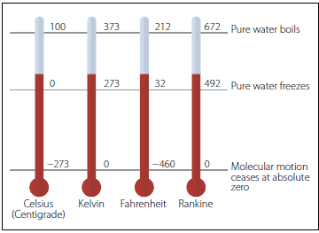
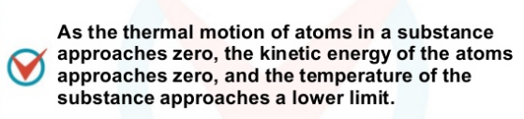
Temperature can be expressed in
Degree Celsius (°C)
Degree Fahrenheit (°F)
(two-point scales)
Kelvin and Rankine
(absolute temperature scales)
The lowest temperature on the Kelvin scale
is absolute zero, or 0 K.
T (°F) = (9/5) T (°C) + 32
T (°R) = T (°F) + 459.67
T (K) = T (°C) + 273.15
Notes:
All temperature scales are based on some easily reproducible states such as the
freezing and boiling points of water, which are also called the ice point and the steam point, respectively.
Absolute zero: Lowest temperature that is theoretically possible,
at which motion of the particles is minimal
The temperature at which no more energy can be extracted from the system.

Slide 34
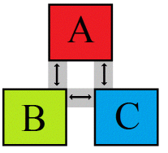
Zeroth Law of Thermodynamics
If two systems or objects are in thermal equilibrium with third system or object , they are also in thermal equilibrium with each other.
It serves as a basis for the validity of temperature measurement.

Slide 35
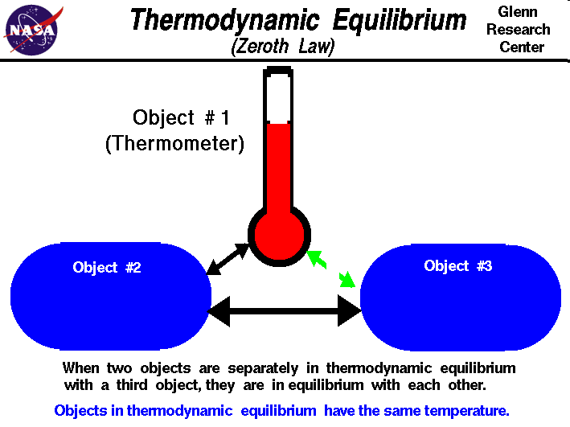
Slide courtesy of NASA
Notes:
By replacing the third body with a thermometer,
the zeroth law can be restated as two bodies are in thermal equilibrium if
both have the same temperature reading even if they are not in contact.

Slide 36
Pressure (Intensive)
Pressure is the normal force exerted by a fluid per unit area.
The normal force on a object is always perpendicular (at a right angle) to the surface the object is on.
Deals with a gas or a liquid.
The counterpart of pressure in solids is normal stress.
It has the unit of Newton's per square meter (N/m²), which is called a pascal (Pa).
1 Pa = 1 (N/m²),
Pressure can be measured in bar, Psi, atm, mmHg, torr
Notes:
The normal force on a object is always perpendicular (at a right angle) to the surface the object is on.

Slide 37
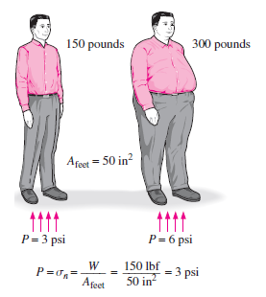

Slide 38
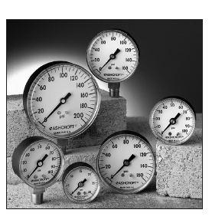
The actual pressure at a given position is called the Absolute pressure.
Absolute Pressure = P _{gauge} + P _{atmospheric}
Difference between the absolute pressure and the local atmospheric pressure is Gauge pressure.
Pressures below atmospheric pressure are called Vacuum pressures.
In thermodynamics, absolute pressure are always used.

Slide 39
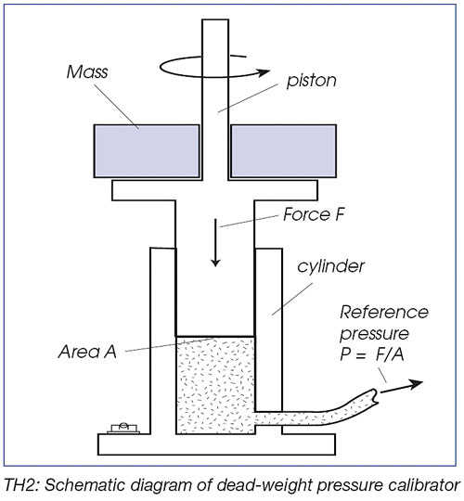
Pressure measurements
Gauges in common use, such as Bourdon gauges, are calibrated by comparison with dead-weight gauges
With this force given by Newton's law, the pressure of the oil is:
P = F/A = mg/A
Dead weight gauge

Slide 40
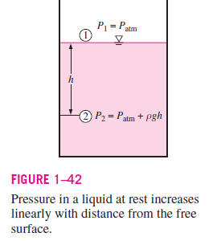
Pressure in vertical column
Vertical column of a given fluid under the influence of gravity exerts a pressure at its base in direct proportion to its height, pressure is also expressed as the equivalent height of a fluid column. This is the basis for the use of manometers for pressure measurement.
m = ρAh
Therefore
ΔP = P₂ - P₁= F/A = mg/A = ρAhg /A = ρgh

Slide 41
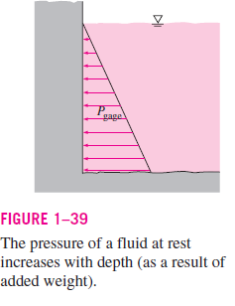
Variation of Pressure with Depth (liquids)
Pressure in a fluid increases linearly with depth because more fluid rests on deeper layers, and the effect of this “extra weight” on a deeper layer is balanced by an increase in pressure.

Slide 42
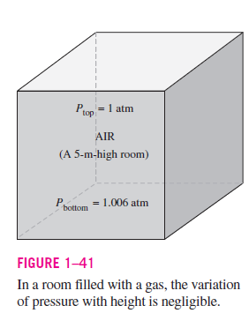
Variation of Pressure with Depth (Gases)
For small to moderate distances, the variation of pressure with height is negligible for gases because of their low density. The pressure in a room filled with air can be assumed to be constant.

Slide 43
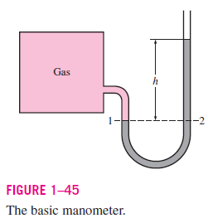
THE MANOMETER
A manometer mainly consists of a glass or plastic U-tube containing one or more fluids such as mercury, water, alcohol, or oil.
To keep the size of the manometer to a manageable level, heavy fluids such as mercury are used if large pressure differences are anticipated.

Slide 44
Consider a manometer that is used to measure the pressure in the tank. Since the gravitational effects of gases are negligible, the pressure in the tank and at point 1 has the same value.
Pressure in a fluid does not vary in the horizontal direction within a fluid, the pressure at point 2 is the same as the pressure at point 1.
P₂ = P₁.
The differential fluid column of height h is in static equilibrium, and it is open to the atmosphere.
Then the pressure at point 2 is determined directly from

Slide 45
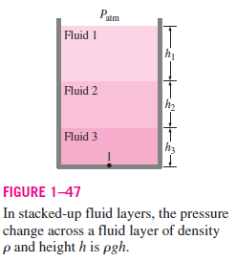


Slide 46
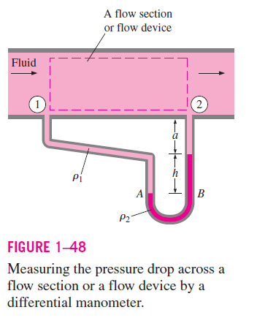


Slide 47
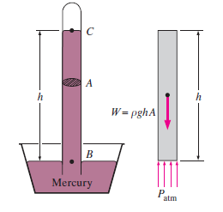
THE BAROMETER AND ATMOSPHERIC PRESSURE
Atmospheric pressure is measured by a device called a barometer.
Atmospheric pressure is often referred to as the barometric pressure.
Atmospheric pressure can be measured by inverting a mercury-filled tube into a mercury container that is open to the atmosphere
Writing a force balance

